Slide 1
BAIRS | New Reports Overview
New/Updated Reports 8/01/12*
*Latest updates 11/19/12

Slide 2
BAIRS Reports: What is changing in FY13?
Introduction
The BFS TempBudg ledger was retired for the Current Fund group as of 7/1/12 (excluding contracts and grants¹). As a result of this change, we have created some updated report versions and new reports to offer improved data presentation and reflect new elements and formats in the Actuals ledger.
Why?
TempBudg is no longer used for these funds
Reports need to reflect new elements and formats in Actuals
Operating transfers
Interfund funds
Beginning balance
Opportunity to improve existing data presentation
¹ TempBudg continues to exist for contract and grant funds, Plant funds, and historical reporting only.
Additional FY13 BFS Changes information and training is available at http://budget.berkeley.edu/.

Slide 3
Table of contents
 | Page
New BAIRS Directory Structure | 4
Non-Contracts & Grants Current Funds Reporting | 6
GL Detail Expanded | 8
GL Customer Report (Non-C&G Current Funds version) | 12
GL Sum Fund Overdraft Report | 16
GL Sum By Five Chartfields | 19
GL Detail Transaction Verification | 25
All Current Funds Reporting | 27
GL Customer Report (All Current Funds version) | 30
GL Sum By Five Chartfields (All Current Funds version) | 33
GL Sum Monthly Expense | 36
GL Detail Expanded | 39
GL Detail Standard | 42
GL Department Fund Summary | 45
Questions and Feedback | 50

Slide 4
Directory Structure: What is changing in FY13?
New Directory Structure
The Financial Reports directory structure has been modified to include two new folders that contain the new reports.
Existing Folders:
GL Detail
GL Summary
Items to note:
The reports in these folders will continue to exist and be operational to all users.
Underlying data views in many of these reports have changed to now include 3xxxx and 7xxxx accounts. Historical results will be unchanged, so bear in mind that departmental activity in 3xxxx and 7xxxx accounts will not be present prior to 7/1/2012.
Newly Created Folders:
GL Reports (Non-C&G Current Funds__New 07-01-2012): Limited to non-Contract and Grants Current funds
GL Reports (All Current Funds__New 07-01-2012) : Allows for single report output that includes Contract and Grants and Non-Contracts and Grants funds
These folders contain:
Newly created versions of old reports
Newly created reports (coming soon)
Note: Permissions to access GL Reports will remain the same.
See screen shot of folder structure on the next slide

Slide 5
New BAIRS Reports Directories:
Two New Folders:
Link to BAIRS Reports: http://rptportal.berkeley.edu/

Slide 6
New BAIRS Reporting on Non-Contract and Grants Current Funds

Slide 7
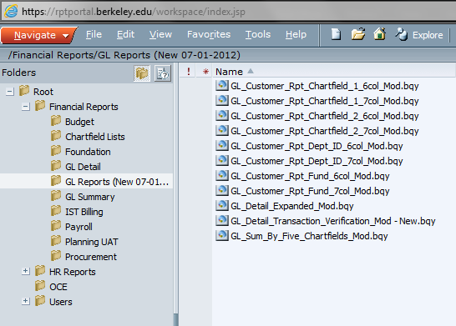
Summary: GL Reports (New 07-01-2012)
The new/updated versions of reports are located in BAIRS at:
http://rptportal.berkeley.edu/ in a new Financial Reports folder named,
“GL Reports (Non-C&G Current Funds__New 07-01-2012).”
New reports include “_mod” as a suffix at the end of each report name.
The new/updated BAIRS reports are:

Slide 8
What Changed: GL Detail Expanded Report
The scope of change in the below new/updated BAIRS reports can be summarized as follows:
Original Report Name: | GL Detail Expanded Report
Description: | GL Detail Expanded report can be used to show full chart string balances and activity.
Modifications: | Balance column adds Actuals + Encumbrances + Pre-encumbrances This report will have a new report view called Full Chartstring. The Full Chartstring report view displays the full chartstring (except business unit) for detail transactions.
Updated Reports: | GL Detail Expanded mod

Slide 9
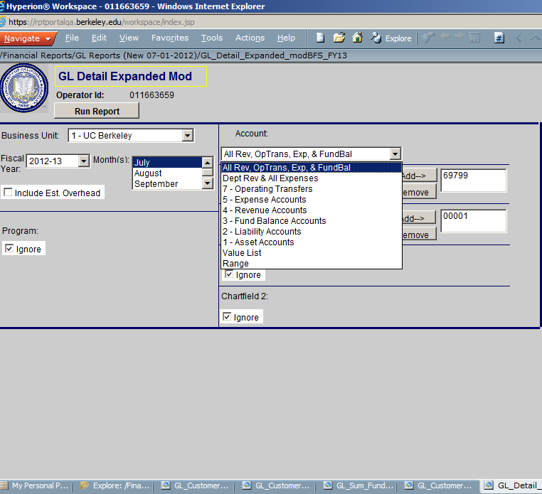
What Changed: GL Detail Expanded Report (Cont’d)
GL Detail Expanded mod
Old
New!
The BAIRS report query window structure stays the same.
Account drop down lists will add “All Rev, OpTrans, Exp & Fund Bal” and “7 – Operating Transfers.”
Fiscal Year will be limited to FY12-13 and future fiscal years.

Slide 10
What Changed: GL Detail Expanded Report (Cont’d)
Old
New!
The BAIRS report type window that allows user to choose which report to view has not changed.
This report now has a new report view called Full Chartstring. The Full Chartstring report view displays the full chartstring (except business unit) for detail transactions.

Slide 11
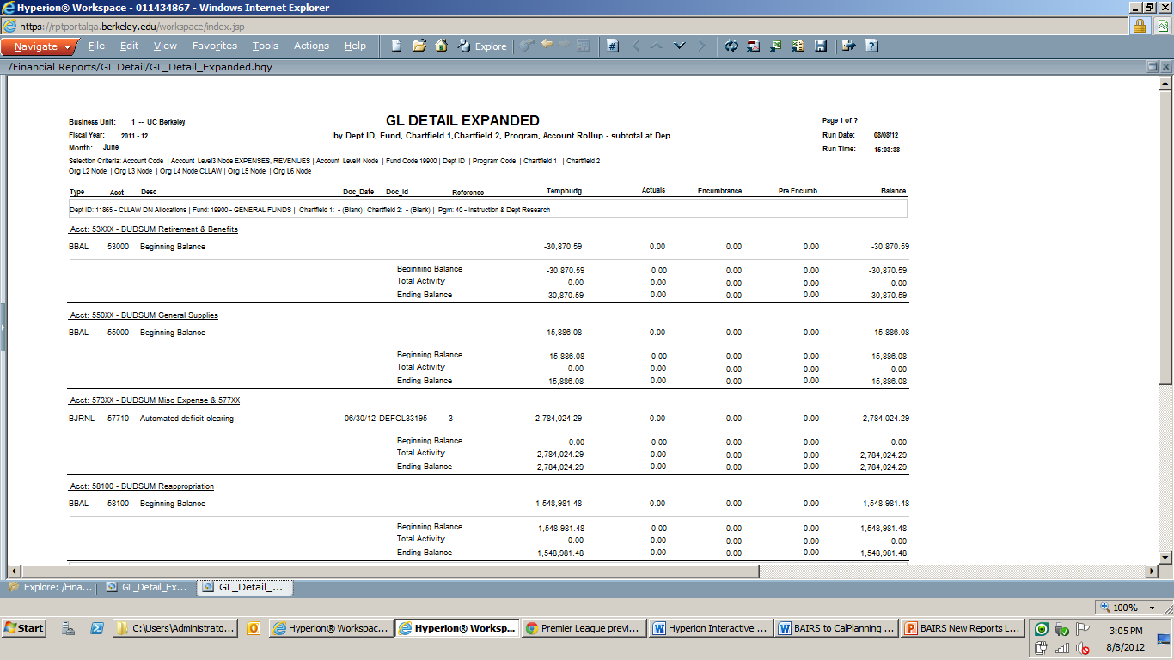
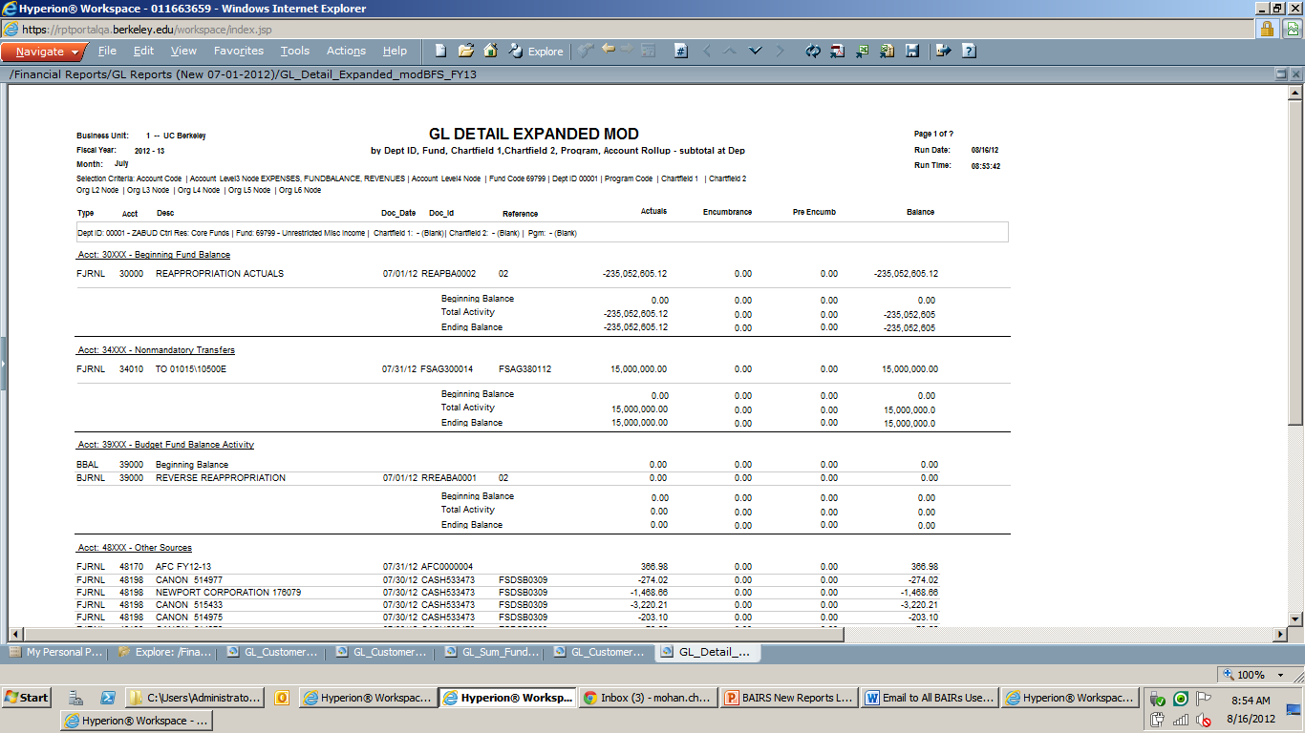
What Changed: GL Detail Expanded Report (Cont’d)
Old
New!
Balance calculation has changed, but header stays the same.
Old Formula: TempBudg + Actuals + Encumbrance + Pre Encumb
New Formula: Actuals + Encumbrance + Pre Encumb
Tempbudg has been removed.

Slide 12
What Changed: GL Customer Reports (non-Contracts & Grants Current Funds version)
The scope of change in the new/updated BAIRS reports can be summarized as follows:
Original Report Name: | GL Customer Reports
Description: | Customer reports provide transaction level detail and summary information about chart of account activity.
Modifications: | Changed “Current Expense Activity” to “Current Actuals Activity” Changed “Total Expenses” to “YTD Actuals” Added functionality to pull 3xxxx and 7xxxx accounts
Updated Reports: | GL Customer Rpt Chartfield 1 6 col mod GL Customer Rpt Chartfield 1 7 col mod GL Customer Rpt Chartfield 2 6 col mod GL Customer Rpt Chartfield 2 7 col mod GL Customer Rpt Dept ID 6 col mod GL Customer Rpt Dept ID 7 col mod GL Customer Rpt Fund 6 col mod GL Customer Rpt Fund 7 col mod

Slide 13
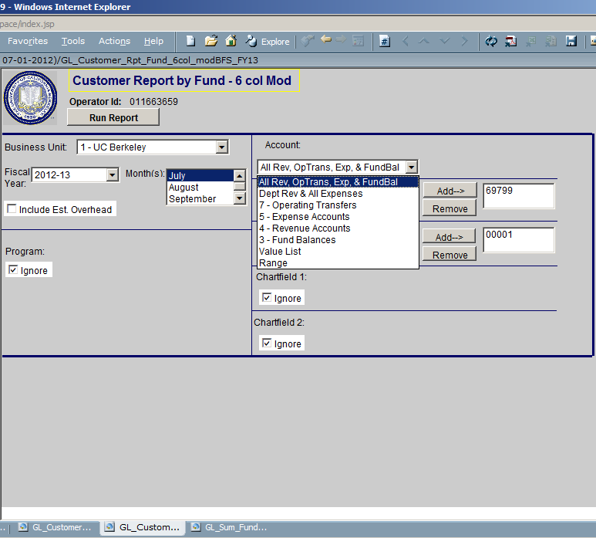
What Changed: GL Customer Reports (Cont’d) (non-Contracts & Grants Current Funds version)
GL Customer Rpt Fund 6 col mod*
Old
New!
The BAIRS report query window structure stays the same.
Account drop down lists will add “All Rev, OpTrans, Exp & Fund Bal”, “7 – Operating Transfers” and “3 – Fund Balance Accounts.”
Fiscal Year will be limited to FY12-13 and future fiscal years.
*Note: All other GL Customer Reports ending with the “_mod” suffix have been similarly modified.

Slide 14
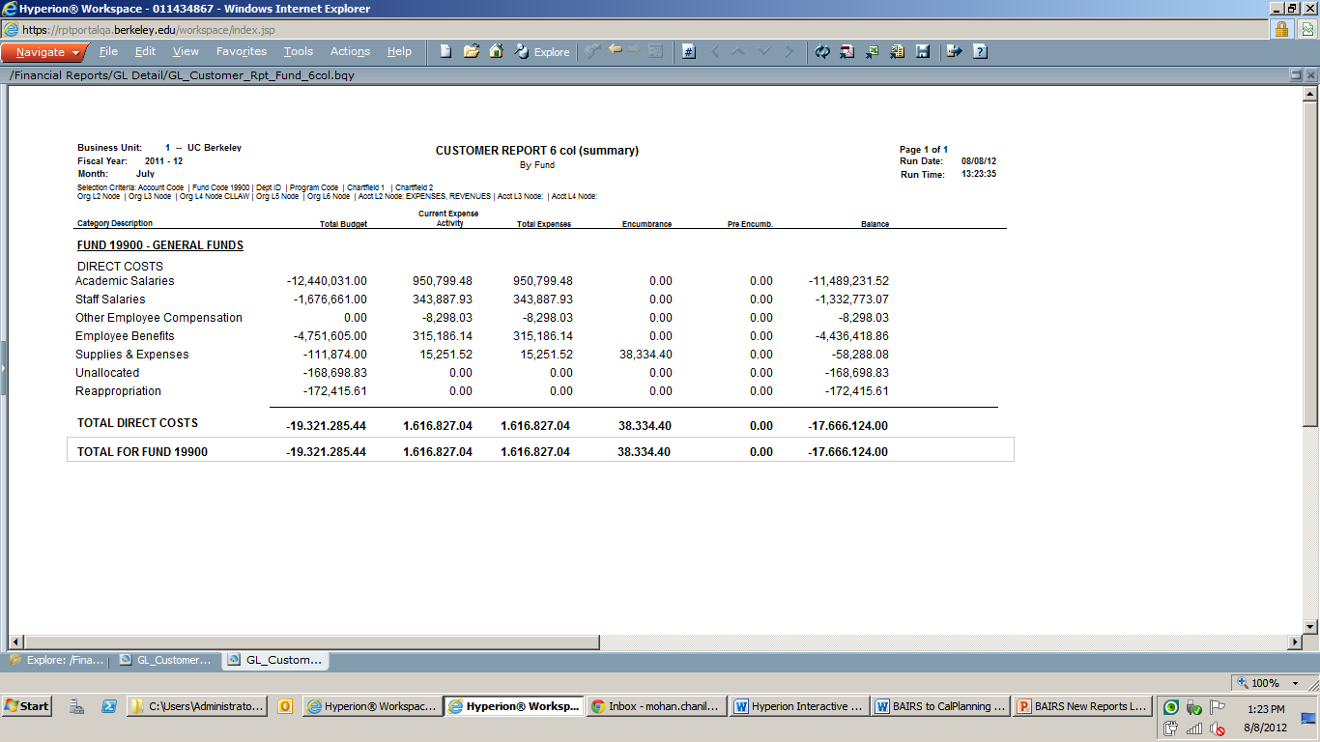
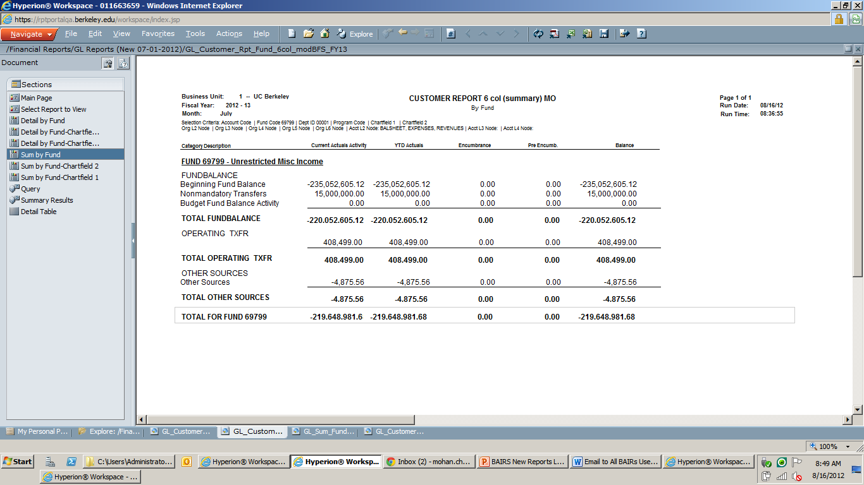
What Changed: GL Customer Reports (Cont’d) (non-Contracts & Grants Current Funds version)
The balance calculation has changed, but the header “Balance”stays the same.
Old Formula = Total Budget + Total Expenses + Encumbrance + Pre Encumb
New Formula = YTD Actuals + Encumbrance + Pre Encumb
GL Customer Rpt Fund 6 col mod*
Old
New!
“Total Budget” column has been removed from new reports since the TempBudg ledger is no longer used for non-C&G Current funds.
“Current Expense Activity” has been renamed “Current Actuals Activity.”
“Total Expenses” has been renamed “YTD Actuals.”
*Note: All other GL Customer Reports ending with the “_mod” suffix have been similarly modified.

Slide 15
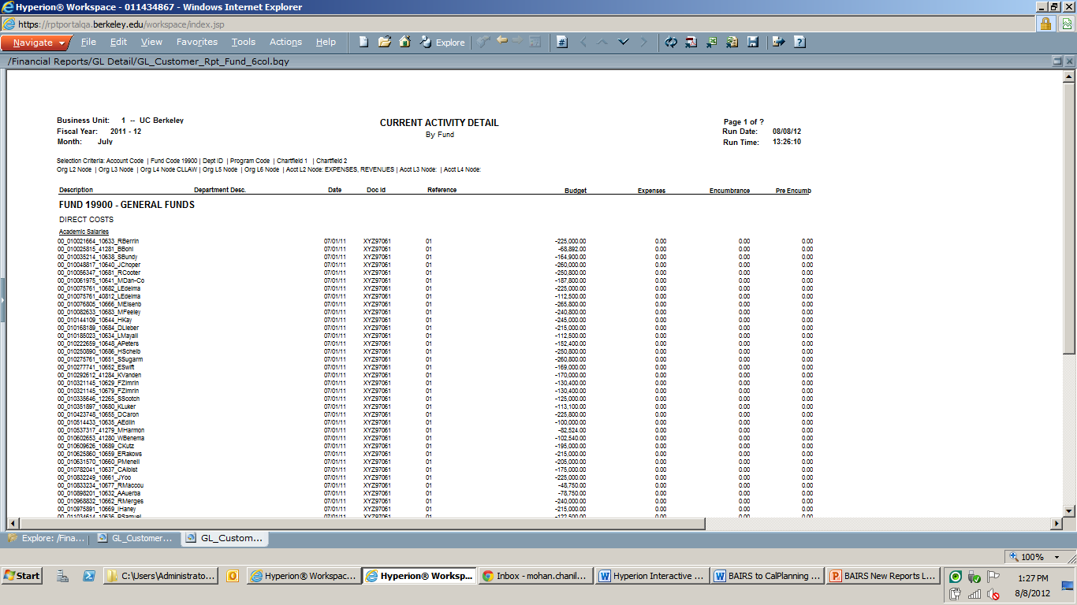
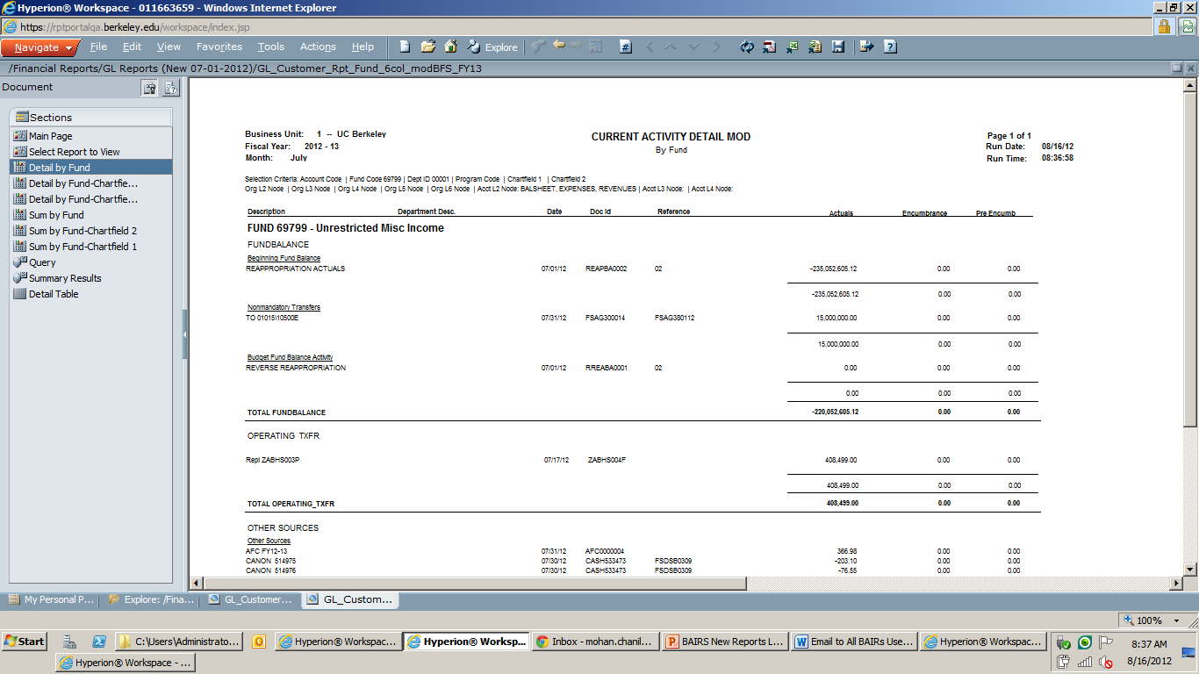
What Changed: GL Customer Reports (Cont’d) (*non-Contracts & Grants Current Funds version)
GL Customer Rpt Fund 6 col mod*
Old
New!
The “Budget” column has been removed from the new reports. The “Expenses” column was renamed “Actuals”.
*Note: All other GL Customer Reports ending with the “_mod” suffix have been similarly modified.

Slide 16
What Changed: GL Sum Fund Overdraft Report
The scope of change in the new/updated BAIRS reports can be summarized as follows:
Original Report Name: | GL Sum Fund Overdraft Report
Description: | Report displays non-contract and grant Current funds in overdraft. Do not use for contract and grant, Plant, Loan or Agency funds.
Modifications: | Balance only calculated as Fund Balance accounts (3xxxx), Operating Transfers (7xxxxx), Revenues (4xxxx) and Expenses (5xxxx), all in Actuals + Encumbrances + Pre Encumbrances Report excludes Contract and Grants
Updated Reports: | GL Sum Fund Overdraft mod

Slide 17
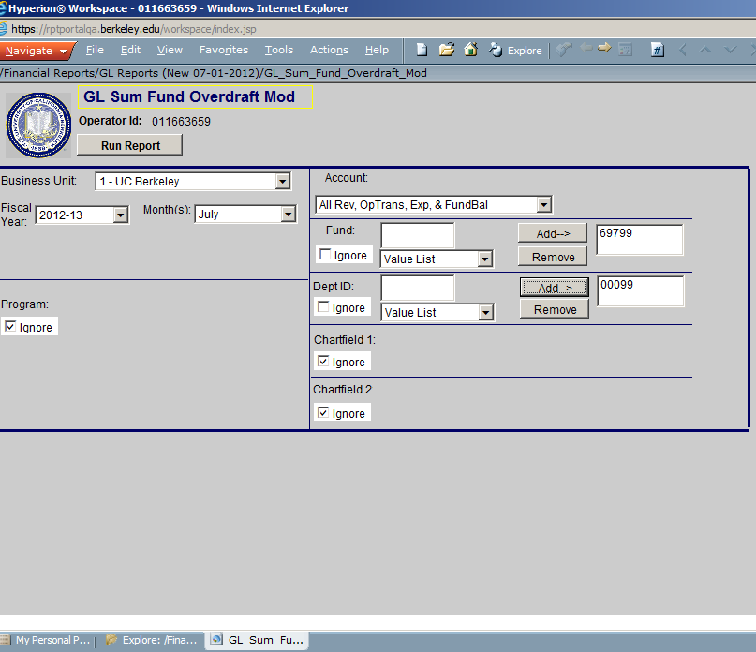
What Changed: GL Sum Fund Overdraft (Cont’d)
GL Sum Fund Overdraft mod
Old
New!
The BAIRS report query window structure stays the same.
Account drop down lists will add “All Rev, OpTrans, Exp & Fund Bal” and “7 – Operating Transfers”.
Fiscal Year will be limited to FY12-13 and future fiscal years.

Slide 18
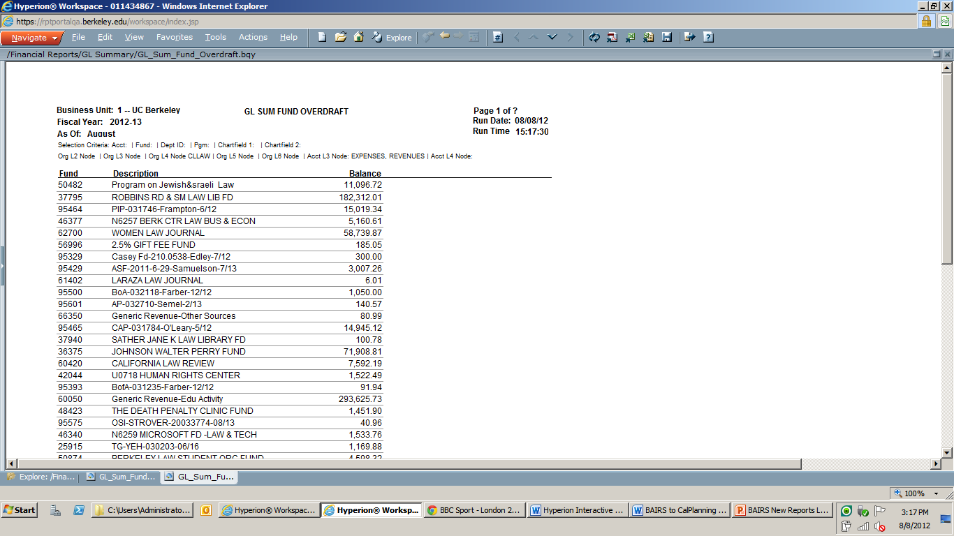
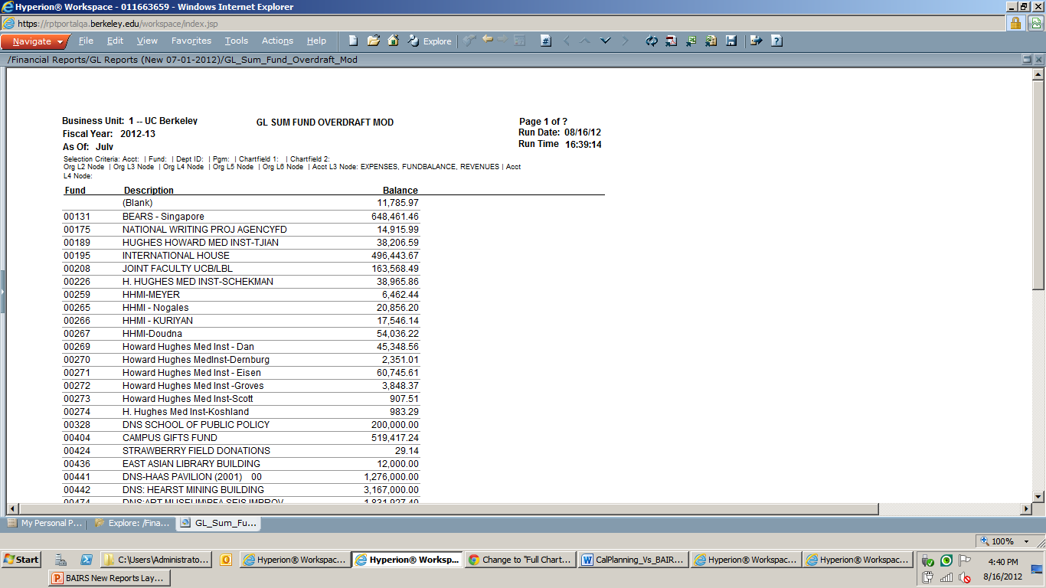
What Changed: GL Sum Fund Overdraft (Cont’d)
Old
New!
Balance calculation has changed, but header stays the same.
Old Formula: Revenue and Expense accounts in both TempBudg and Actuals ledgers + Encumbrance + Pre Encumb
New Formula: Revenue, Expense, Operating Transfer and Fund Balance accounts in Actuals ledger + Encumbrance + Pre Encumb

Slide 19
What Changed: GL Sum By Five Chartfields
The scope of change in the new/updated BAIRS reports can be summarized as follows:
Original Report Name: | GL Sum By Five Chartfields
Description: | Summarizes Actuals, encumbrances and pre-encumbrances for each unique combination of Dept ID-Fund-ChartField1-ChartField2-Program, with grand totals for the first field in the selected sort order (Fund, Dept ID, or ChartField2).
Modifications: | Removed “TempBudg” column Changed “Actuals” to “YTD Actuals” Added functionality to pull 3xxxx and 7xxxx accounts Created 3 new views excluding Program Code to facilitate reporting on balances for chartstring combinations
Updated Reports: | GL Sum By Five Chartfields mod

Slide 20
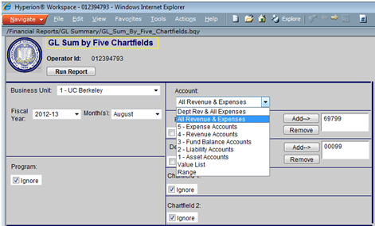
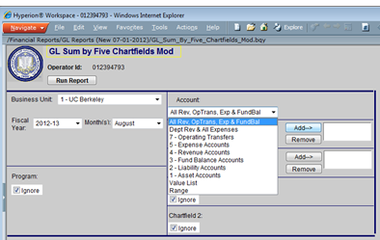
What Changed: GL Sum By Five Chartfields (Cont’d)
GL Sum By Five Chartfields mod
Old
New!
The BAIRS report query window structure stays the same.
Account drop down lists will add “All Rev, OpTrans, Exp & Fund Bal” and “7 – Operating Transfers.”
Fiscal Year will be limited to FY12-13 and future fiscal years.

Slide 21
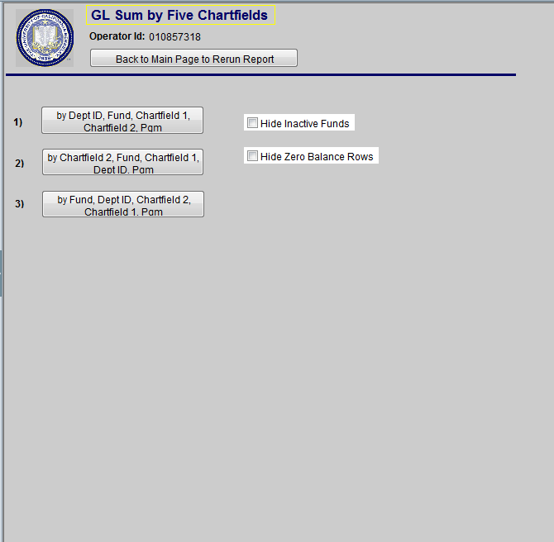
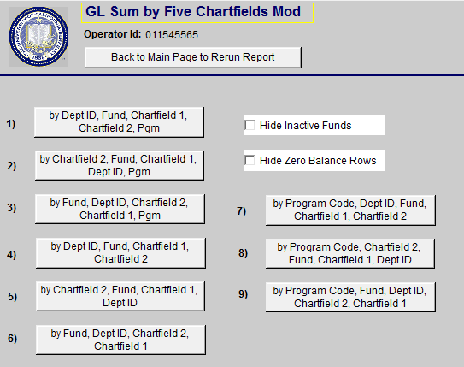
What Changed: GL Sum By Five Chartfields (Cont’d)
GL Sum By Five Chartfields mod
Old
New!
The report view window has six new views (#4-9):
by Dept ID, Fund, Chartfield 1, Chartfield 2
by Chartfield 2, Fund, Chartfield 1, Dept ID
by Fund, Dept ID, Chartfield 2, Chartfield 1
by Program Code, Dept ID, Fund Chartfield 1, Chartfield 2
by Program Code, Chartfield 2, Fund, Chartfield 1, Dept ID
by Program Code, Fund, Dept ID, Chartfield 2, Chartfield 1

Slide 22
What Changed: GL Sum By Five Chartfields (Cont’d)
Three new views now exclude Program Code from the report, allowing for accurate reporting on balances for different chartstring combinations (from 7/1/2012 forward)
The original views can still be used to see Program Code

Slide 23
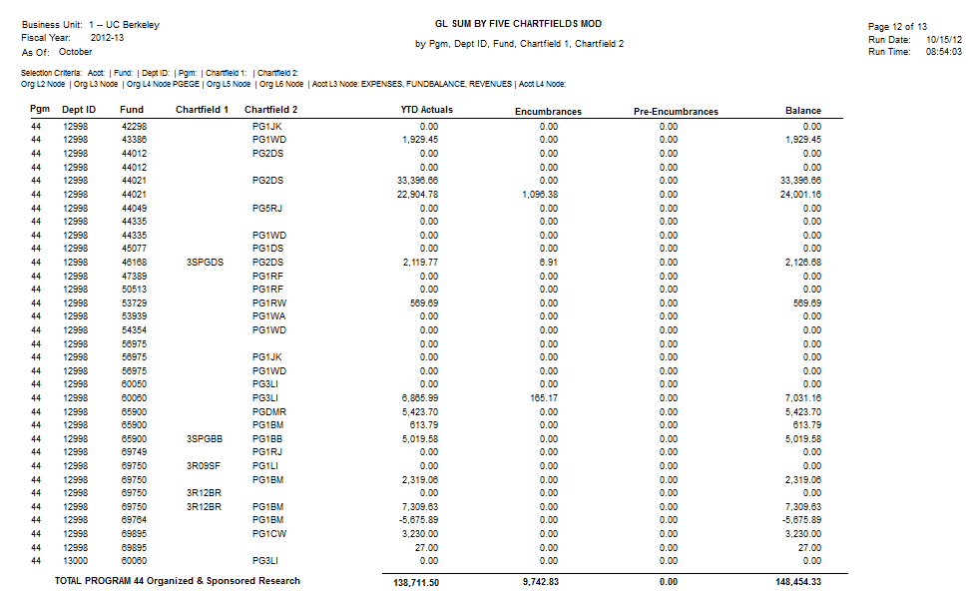
What Changed: GL Sum By Five Chartfields (Cont’d)
Three reports grouping by Program code:
By Pgm, DeptID, Fund, CF1, CF2
By Pgm, CF2, Fund, CF1, DeptID
By Pgm, Fund, DeptID, CF2, CF1

Slide 24
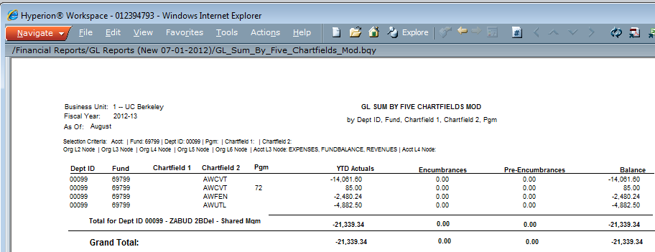
What Changed: GL Sum By Five Chartfields (Cont’d)
GL Sum By Five Chartfields mod
Old
New!
The “TempBudg” column has been removed from the new reports. The “Actuals” column was renamed “YTD Actuals”.

Slide 25
What Changed: GL Detail Transaction Verification
The scope of change in the new/updated BAIRS reports can be summarized as follows:
Original Report Name: | GL Detail Transaction Verification
Description: | Can contain transactions posted to your Dept IDs by another processing unit, including recharges, grant/gift appropriations, and errors prepared in another department using your Dept ID. This report can provide your own processing unit's PCard transactions as well.
Modifications: | Account Dropdown “All Rev, OpTrans, Exp, & FundBal” added to dashboard for accurate non-contract and grant current fund transaction verification
Updated Reports: | GL Detail Transaction Verification Mod

Slide 26
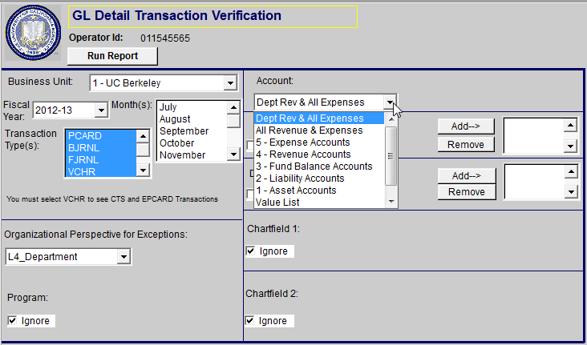
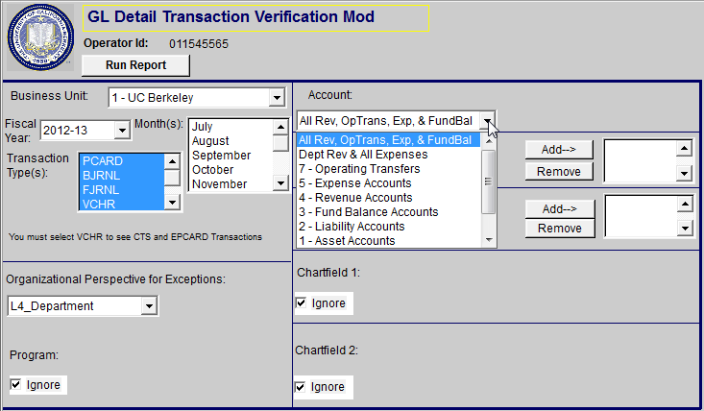
What Changed: GL Detail Transaction Verification (Cont’d)
GL Detail Transaction Verification mod
Old
New!
The BAIRS report query window structure stays the same.
Account drop down lists will add “All Rev, OpTrans, Exp & Fund Bal” and “7 – Operating Transfers”.
Fiscal Year will be limited to FY12-13 and future fiscal years.

Slide 27
‘All Current FundS’ Reporting
New reports to facilitate reporting on Contracts & Grants and Non-Contracts & Grants Current Funds in a single report

Slide 28
Summary: GL Reports (All Current Funds New 07-01-2012)
New Reports are now available for reporting on both Contracts & Grants and non-Contracts & Grants current funds.
Reports can contain:
Contracts & Grants funds: TempBudg and Actual data AND
Non- Contracts & Grants Current funds: Actuals, including Transfers data
Users can filter if only “Contracts & Grants Funds” or “Non-Contracts & Grants Funds” are desired. Please note: Ignoring the filter retrieves all current funds.
Reports allow users to look at both the “Department” and “All” levels for Revenue, Operating Transfers, Expenses and Fund Balances.
Dept contains C+G: 5xxxx accounts + Non-C&G: 3xxxx. 4xxxx, 5xxxx, 7xxxx accounts
All contains C+G: 4xxxx, 5xxxx accounts + Non-C&G: 3xxxx. 4xxxx, 5xxxx, 7xxxx accounts

Slide 29
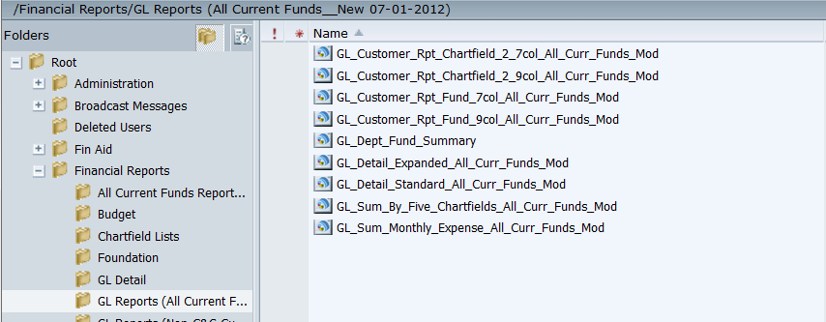
Summary: GL Reports (All Current Funds New 07-01-2012)
The new/updated versions of reports are located in BAIRS at:
http://rptportal.berkeley.edu/ in a new Financial Reports folder named,
“GL Reports (All Current Funds New 07-01-2012).”
New reports include “_All Curr Funds Mod” as a suffix at the end of each report name.
The new/updated BAIRS reports are:

Slide 30
What Changed: GL Customer Reports (All Current Funds version)
The scope of change in the new/updated BAIRS reports can be summarized as follows:
Original Report Name: | GL Customer Reports
Description: | Customer reports provide transaction level detail and summary information about chart of account activity.
Modifications: | Changed “Current Expense Activity” to “Current Actuals Activity” Changed “Total Expenses” to “YTD Actuals” Added functionality to pull 3xxxx and 7xxxx accounts Added the new Fund Type filter to select between C&G and Non-C&G funds
Updated Reports: | GL Customer Rpt Chartfield 2 7 col All Curr Funds Mod GL Customer Rpt Chartfield 2 9 col All Curr Funds Mod GL Customer Rpt Fund 7 col All Curr Funds Mod GL Customer Rpt Fund 9 col All Curr Funds Mod

Slide 31
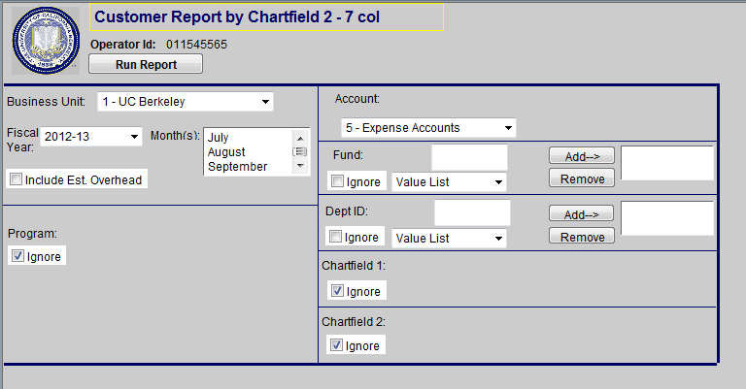
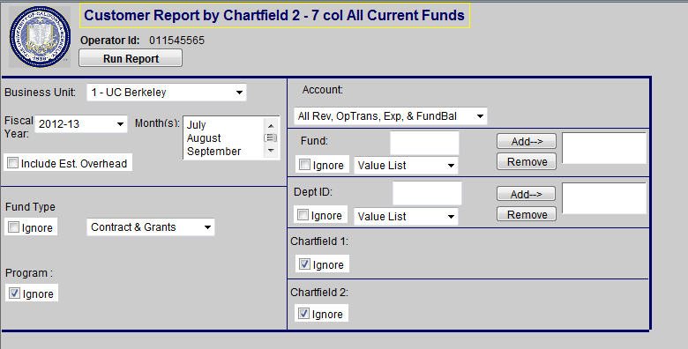
What Changed: GL Customer Reports (Cont’d) (All Current Funds version)
GL Customer Rpt Chartfield 2 7 col All Curr Funds Mod*
Old
New!
The BAIRS report query window structure stays the same.
Account drop down lists will add “All Rev, OpTrans, Exp & Fund Bal”, “7 – Operating Transfers” and “3 – Fund Balance Accounts.”
Fiscal Year will be limited to FY12-13 and future fiscal years.
Reports contain the new Fund Type filter.
*Note: All other GL Customer Reports ending with the “_All Curr Funds Mod” suffix have been similarly modified.

Slide 32
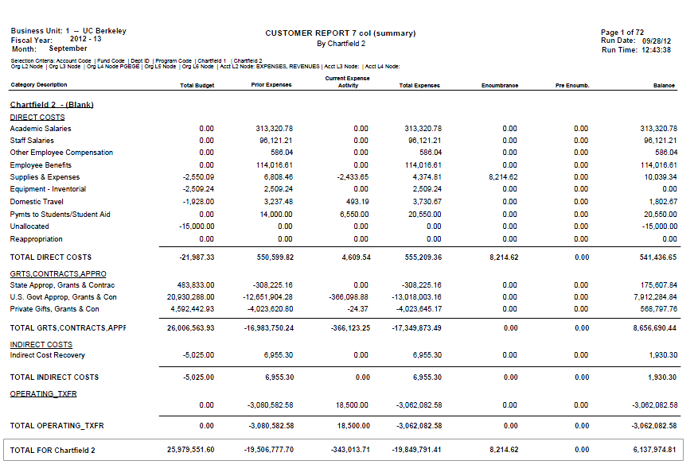
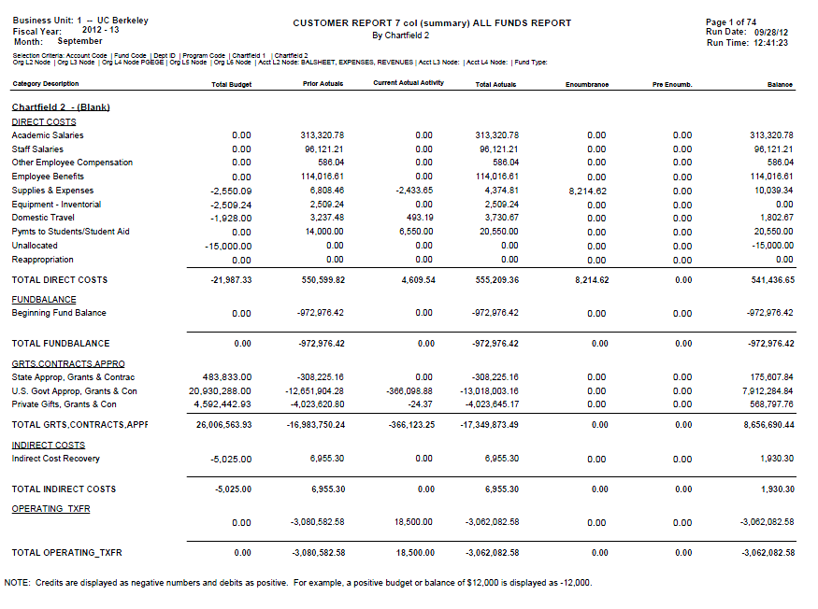
What Changed: GL Customer Reports (Cont’d) (All Current Funds version)
GL Customer Rpt Chartfield 2 7 col All Curr Funds Mod*
Old
New!
The BAIRS report query window structure stays the same.
Account drop down lists will add “All Rev, OpTrans, Exp & Fund Bal”, “7 – Operating Transfers” and “3 – Fund Balance Accounts.”
Fiscal Year will be limited to FY12-13 and future fiscal years.
Reports containt the new Fund Type filter.
*Note: All other GL Customer Reports ending with the “_All Curr Funds Mod” suffix have been similarly modified.

Slide 33
What Changed: GL Sum by Five Chartfields (All Current Funds version)
The scope of change in the new/updated BAIRS reports can be summarized as follows:
Original Report Name: | GL Sum by Five Chartfields
Description: | Summary report that display variations of the five chartfields
Modifications: | Changed “Total Expenses” to “YTD Actuals” Added functionality to pull 3xxxx and 7xxxx accounts Added the new Fund Type filter to select between C&G and Non-C&G funds
Updated Reports: | GL Sum by Five Chartfields All Curr Funds Mod

Slide 34
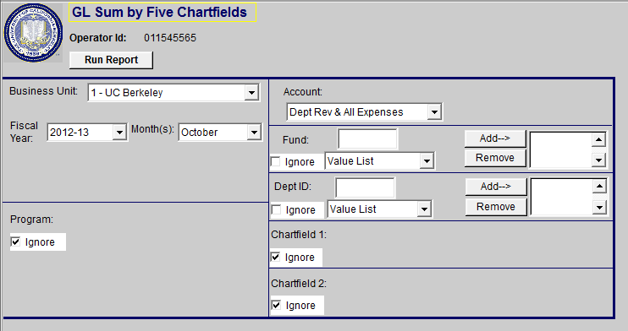
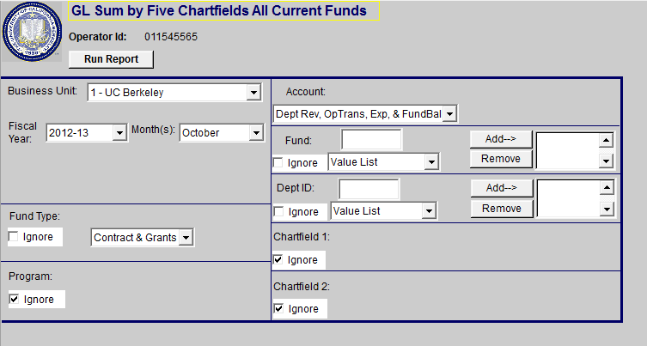
What Changed: GL Sum by Five Chartfields (Cont’d) (All Current Funds version)
GL Sum by Five Chartfields All Curr Funds Mod*
Old
New!
The BAIRS report query window structure stays the same.
Account drop down lists will add “All Rev, OpTrans, Exp & Fund Bal”, “Dept Rev, OpTrans, Exp & Fund Bal”, “7 – Operating Transfers” and “3 – Fund Balance Accounts.”
Fiscal Year will be limited to FY12-13 and future fiscal years.
Reports contain the new Fund Type filter.
.

Slide 35
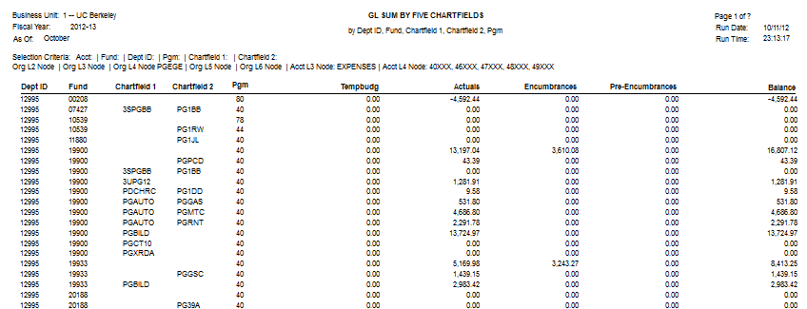
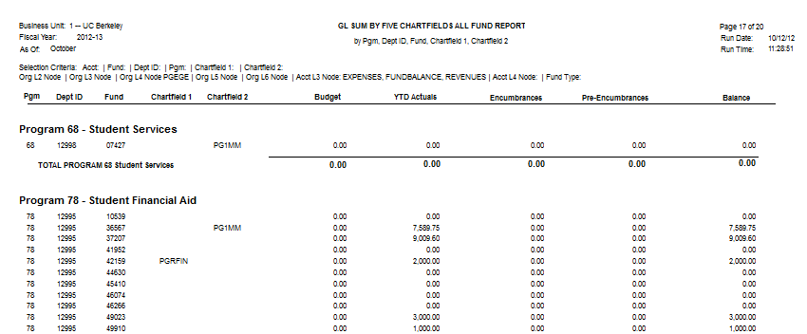
What Changed: GL Sum by Five Chartfields (Cont’d) (All Current Funds version)
GL Sum by Five Chartfields All Curr Funds Mod*
Old
New!
Full chartfield is displayed. Additional 3 new report views available to subtotal by Program Code.

Slide 36
What Changed: GL Sum Monthly Expense (All Current Funds version)
The scope of change in the new/updated BAIRS reports can be summarized as follows:
Original Report Name: | GL Sum Monthly Expense
Description: | Detail report that displays actuals (expenses, revenues, transfers) broken out for each month of the fiscal year. Available by Dept ID, Fund, ChartField2, ChartField1, etc.
Modifications: | Added functionality to pull 3xxxx and 7xxxx accounts Added the new Fund Type filter to select between C&G and Non-C&G funds
Updated Reports: | GL Sum Monthly Expense All Curr Funds Mod

Slide 37
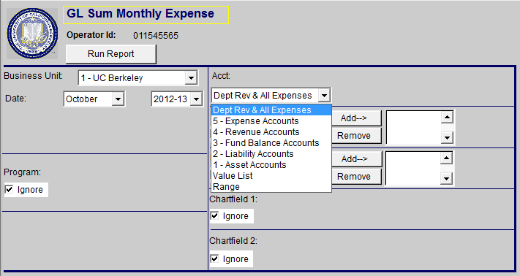
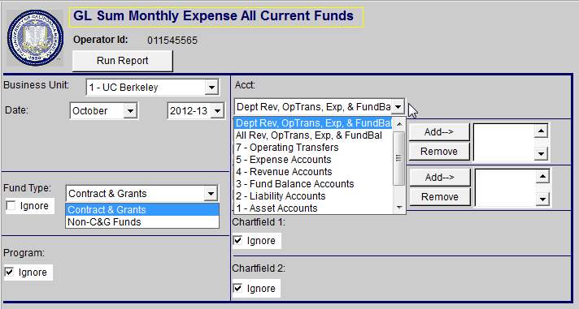
What Changed: GL Sum Monthly Expense (Cont’d) (All Current Funds version)
GL Sum Monthly Expense All Curr Funds Mod*
Old
New!
The BAIRS report query window structure stays the same.
Account drop down lists will add “All Rev, OpTrans, Exp & Fund Bal”, “Dept Rev, OpTrans, Exp & Fund Bal”, “7 – Operating Transfers” and “3 – Fund Balance Accounts.”
Fiscal Year will be limited to FY12-13 and future fiscal years.
Reports contain the new Fund Type filter.

Slide 38
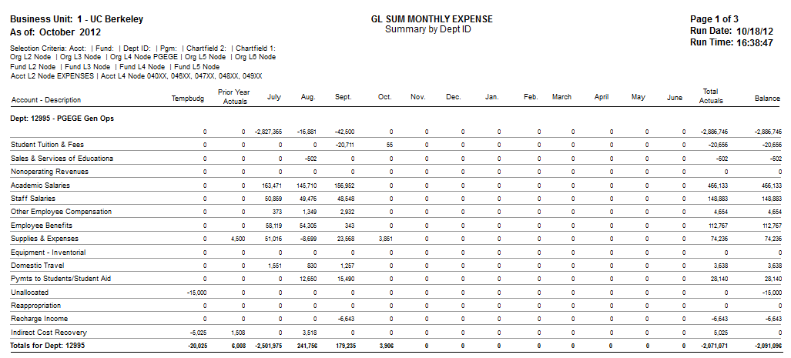
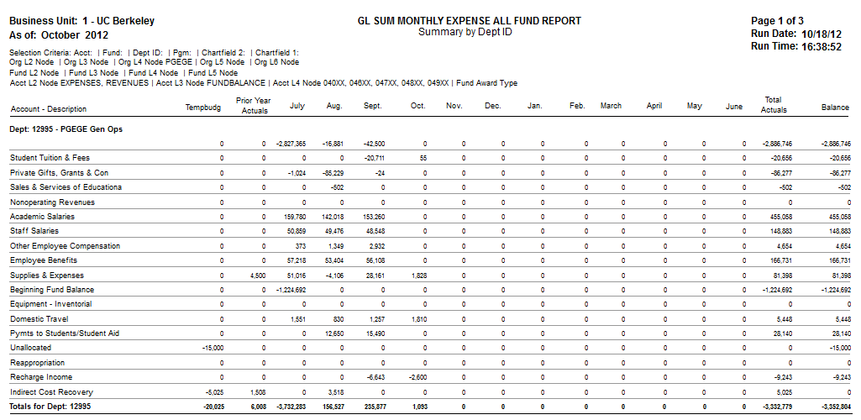
What Changed: GL Sum Monthly Expense (Cont’d) (All Current Funds version)
GL Sum Monthly Expense All Curr Funds Mod*
Old
New!
No changes to prior report formats.

Slide 39
What Changed: GL Detail Expanded (All Current Funds version)
The scope of change in the new/updated BAIRS reports can be summarized as follows:
Original Report Name: | GL Detail Expanded
Description: | Detail report that displays details of the transaction
Modifications: | Added functionality to pull 3xxxx and 7xxxx accounts Added the new Fund Type filter to select between C&G and Non-C&G funds
Updated Reports: | GL Detail Expanded All Curr Funds Mod

Slide 40
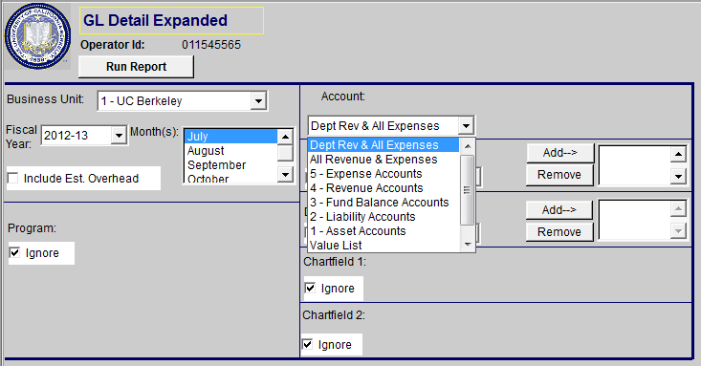
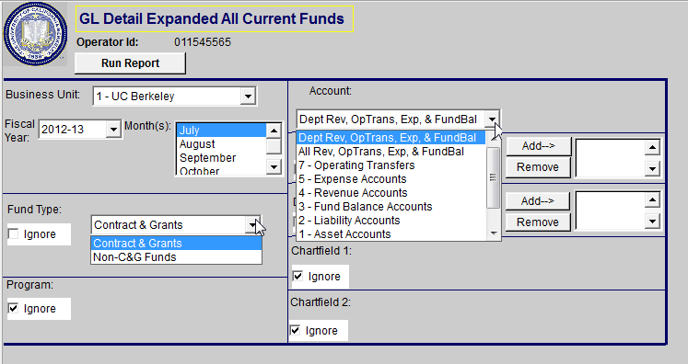
What Changed: GL Detail Expanded (Cont’d) (All Current Funds version)
GL Detail Expanded All Curr Funds Mod*
Old
New!
The BAIRS report query window structure stays the same.
Account drop down lists will add “All Rev, OpTrans, Exp & Fund Bal”, “Dept Rev, OpTrans, Exp & Fund Bal”, “7 – Operating Transfers” and “3 – Fund Balance Accounts.”
Fiscal Year will be limited to FY12-13 and future fiscal years.
Reports contain the new Fund Type filter.

Slide 41
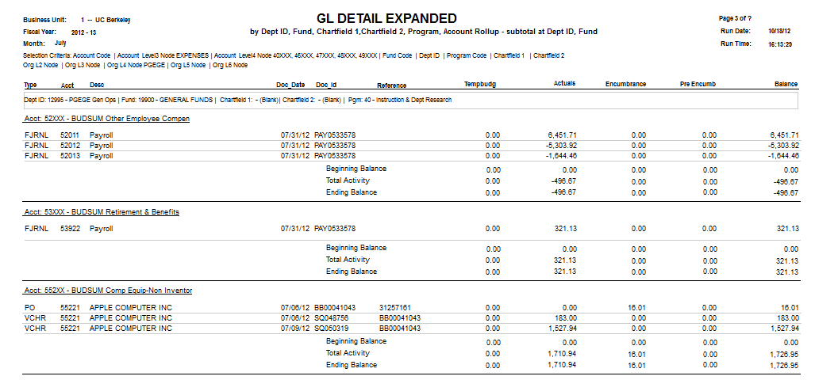
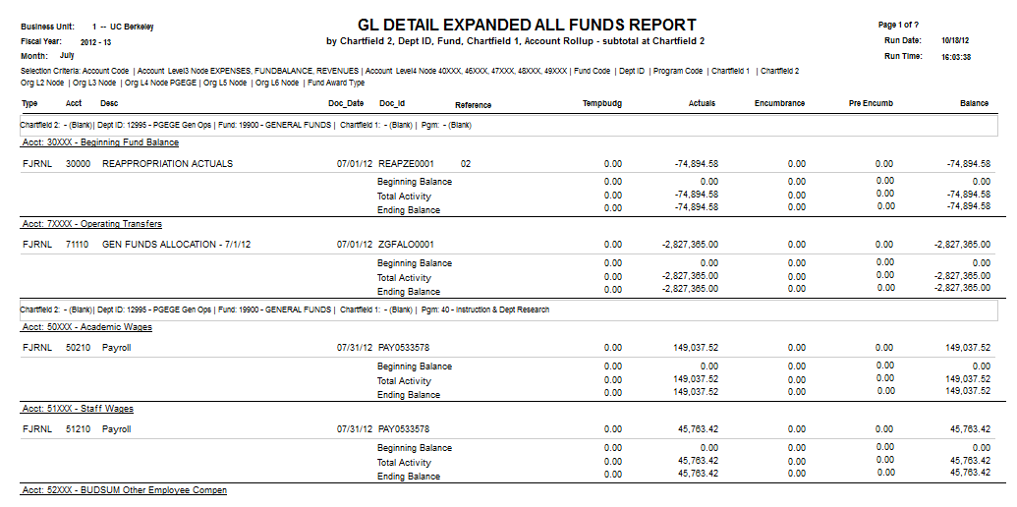
What Changed: GL Detail Expanded (Cont’d) (All Current Funds version)
GL Detail Expanded All Curr Funds Mod*
Old
New!
Line detail is displayed. No changes to prior report formats.
*Note: All other GL Customer Reports ending with the “_All Curr Funds Mod” suffix have been similarly modified.

Slide 42
What Changed: GL Detail Standard (All Current Funds version)
The scope of change in the new/updated BAIRS reports can be summarized as follows:
Original Report Name: | GL Detail Standard
Description: | Detail report that displays details of the transaction
Modifications: | Added functionality to pull 3xxxx and 7xxxx accounts Added the new Fund Type filter to select between C&G and Non-C&G funds
Updated Reports: | GL Detail Standard All Curr Funds Mod

Slide 43
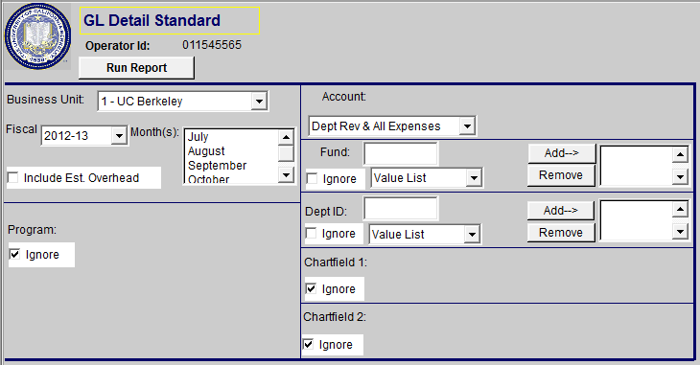
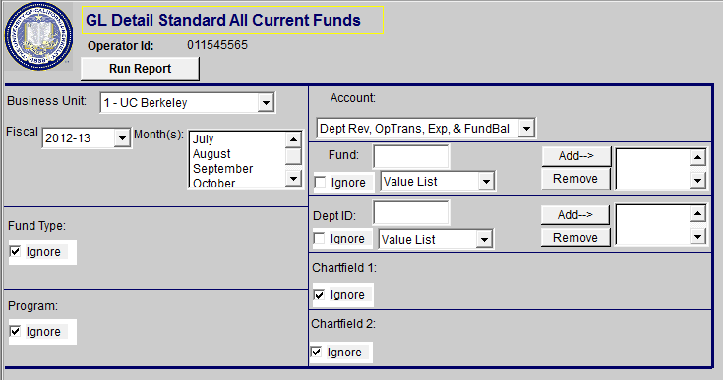
What Changed: GL Detail Standard (Cont’d) (All Current Funds version)
GL Detail Standard All Curr Funds Mod*
Old
New!
The BAIRS report query window structure stays the same.
Account drop down lists will add “All Rev, OpTrans, Exp & Fund Bal”, “Dept Rev, OpTrans, Exp & Fund Bal”, “7 – Operating Transfers” and “3 – Fund Balance Accounts.”
Fiscal Year will be limited to FY12-13 and future fiscal years.
Reports contain the new Fund Type filter.

Slide 44
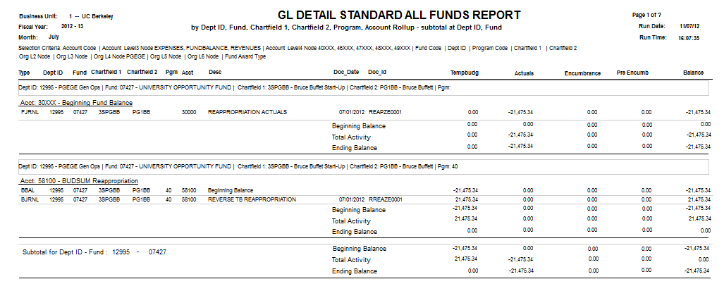
What Changed: GL Detail Standard (Cont’d) (All Current Funds version)
GL Detail Standard All Curr Funds Mod*
Old
New!
Line detail is displayed. No changes to prior report formats. However, Tempbudg column only contains data for Contracts & Grants funds.
*Note: All other GL Customer Reports ending with the “_All Curr Funds Mod” suffix have been similarly modified.

Slide 45
GL Department Fund Summary (All Current Funds version)
The new BAIRS reports can be summarized as follows:
Original Report Name: | GL Department Fund Summary
Description: | Summary report that displays Actuals data with account groupings by fund or department at multiple levels.
Features: | Combination of both formatted reports and pivot tables
New Reports: | 1 New Report by Fund and Account groupings 3 New Reports by Org and Account groupings High (Division) L3 Org Mid (Department) L4 Org Low (DeptID) L7 Org

Slide 46
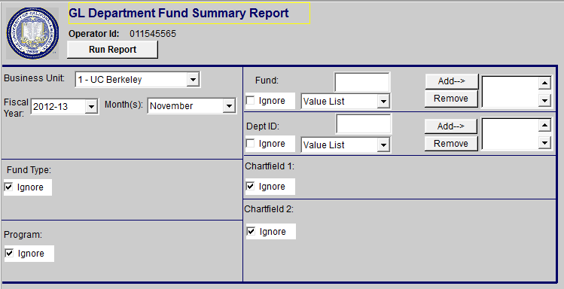
GL Department Fund Summary (Cont’d) (All Current Funds version)
The BAIRS report query window structure stays the same.
Account selection removed. By default, queries 3xxxx, 4xxxx, 5xxxx, 7xxxx
Fiscal Year will be limited to FY12-13 and future fiscal years.
Reports contain the new Fund Type filter.

Slide 47
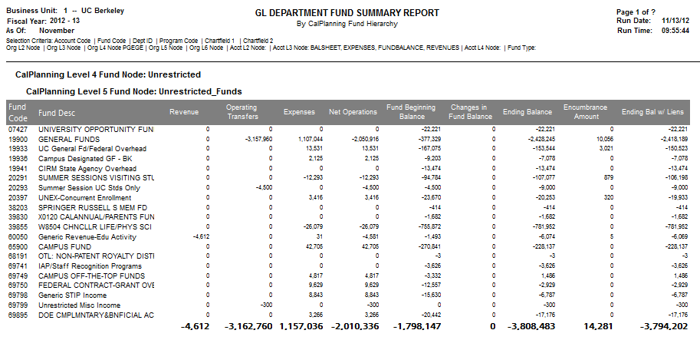
GL Department Fund Summary (Cont’d) (All Current Funds version)
New BAIRS report utilizing the CalPlan Fund Hierarchy to report on Actuals by Account Groupings
Financial data updated nightly

Slide 48
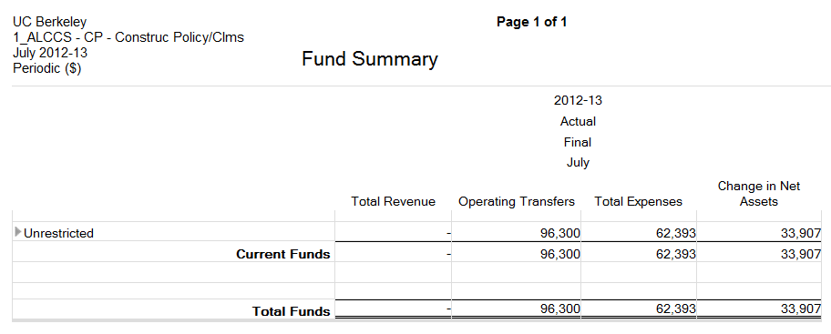
GL Department Fund Summary (Cont’d) (All Current Funds version)
CalPlanning Side-by-Side Comparison
BAIRS
CalPlanning (CR006) – Fund Summary
Report on L4 Department Actuals
Report on Low Level DeptID (L7) Actuals grouped by L4 Departments
Utilizes CalPlanning fund hierarchy
New funds that have been created in BFS during the month that have not yet been assigned a fund type in the CalPlan hierarchy will temporarily be categorized under a column in the report called ‘Missing fund node’

Slide 49
GL Department Fund Summary (Cont’d) (All Current Funds version)
3 New Actuals Reports by Org and Account groupings
High (Division) L3 Org
Mid (Department) L4 Org
Low (DeptID) L7 Org
Updated nightly

Slide 50
BAIRS Reports: Questions and Feedback
If have any questions or feedback, please email the BFS/BAIRS helpdesk at bfsbairs@berkeley.edu or call 642-8500, options 4, 2.

